Slide 1
Introduction to PIG
Presented By
Rahul Pradhan
Dept of Computer Engineering & Applications
GLA University India

Slide 2
Agenda
Learning Objectives | Learning Outcomes
Introduction to Pig To study the key features and anatomy of Pig. To study the execution modes of Pig. To study the various relational operators in pig. | To have an easy comprehension on when to use and when NOT to use Pig. To be able to differentiate between Pig and Hive.

Slide 3
Agenda
What is Pig?
Key Features of Pig
The Anatomy of Pig
Pig on Hadoop
Pig Philosophy
Pig Latin Overview
Pig Latin Statements
Pig Latin: Identifiers
Pig Latin: Comments
Data Types in Pig
Simple Data Types
Complex Data Types

Slide 4
Agenda
Running Pig
Execution Modes of Pig
Relational Operators
Eval Function
Piggy Bank
When to use Pig?
When NOT to use Pig?
Pig versus Hive

Slide 5
What is Pig?
Apache Pig is a platform for data analysis.
It is an alternative to Map Reduce Programming.
Pig was developed as a research project at Yahoo.

Slide 6
Features of Pig
It provides an engine for executing data flows (how your data should flow). Pig processes data in parallel on the Hadoop cluster.
It provides a language called “Pig Latin” to express data flows.
Pig Latin contains operators for many of the traditional data operations such as join, filter, sort, etc.
It allows users to develop their own functions (User Defined Functions) for reading, processing, and writing data.

Slide 7
The Anatomy of Pig
The main components of Pig are as follows:
Data flow language (Pig Latin).
Interactive shell where you can type Pig Latin statements (Grunt).
Pig interpreter and execution engine.

Slide 8
Pig on Hadoop
Pig runs on Hadoop.
Pig uses both Hadoop Distributed File System and MapReduce Programming.
By default, Pig reads input files from HDFS. Pig stores the intermediate data (data produced by MapReduce jobs) and the output in HDFS.
However, Pig can also read input from and place output to other sources.

Slide 9
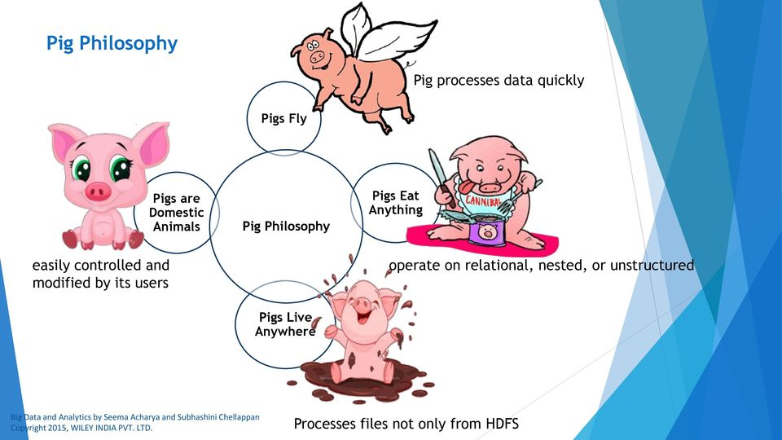
Pig Philosophy
Pig Philosophy
Pigs Fly
Pigs Eat Anything
Pigs Live Anywhere
Pigs are Domestic Animals

Slide 10
Pig Latin Overview: Statements
Pig Latin Statements are generally ordered as follows:
LOAD statement that reads data from the file system.
Series of statements to perform transformations.
DUMP or STORE to display/store result.
Here A is relation and NOT a variable
A = load 'student' (rollno, name, gpa);
A = filter A by gpa > 4.0;
A = foreach A generate UPPER (name);
STORE A INTO ‘myreport’

Slide 11
Pig Latin Overview: Comments
In Pig Latin two types of comments are supported:
Single line comments that begin with “--” (two hyphens).
Multiline comments that begin with “/* and end with */”.

Slide 12
Pig Latin Overview: Identifiers
Valid Identifiers
Y
A1
A1_2014
Sample

Slide 13
Pig Latin Overview: Operators
Arithmetic | Comparison | Null | Boolean
+ | = = | IS NULL | AND
- | ! = | IS NOT NULL | OR
* | < |  | NOT
/ | >
% | <=
 | >=

Slide 14
Data Types in PIG
Simple Data Types
Name | Description
int | Whole numbers
long | Large whole numbers
float | Decimals
double | Very precise decimals
chararray | Text strings
bytearray | Raw bytes
datetime | Datetime
boolean | true or false
Complex Data Types
Name | Description
Tuple | An ordered set of fields. Example: (2,3)
Bag | A collection of tuples. Example: {(2,3),(7,5)}
map | key, value pair (open # Apache)

Slide 15
Running Pig
Pig can run in two ways:
Interactive Mode
Invoke grunt Shell
Type pig to get grunt shell
A= load ‘/pigdemo/student.tsv’ as ( rollno, name, gpa );
DUMP A;
Batch Mode
Create Pig Script to run pig in batch mode
Write Pig Latin Statements in a file and save it “.pig” extension

Slide 16
Execution Modes of Pig
You can execute pig in two modes:
Local Mode
You need to have your files in local file system
Pig –x local filename
Map Reduce Mode (Default Mode)
You need to have access to a Hadoop Cluster to read/write file.
pig filename

Slide 17
Relational Operators
FILTER
FOREACH
GROUP
DISTINCT
LIMIT
ORDERBY
JOIN
UNION
SPLIT
SAMPLE

Slide 18
FILTER-BY
Find the tuples of those student where the GPA is greater than 4.0.
A = load '/pigdemo/student.tsv' as (rollno:int, name:chararray, gpa:float);
B = filter A by gpa > 4.0;
DUMP B;

Slide 19
FOREACH
Display the name of all students in uppercase.
A = load '/pigdemo/student.tsv' as (rollno:int, name:chararray, gpa:float);
B = foreach A generate UPPER (name);
DUMP B;

Slide 20
LIMIT
Display first 3 rows.
A = load '/pigdemo/student.tsv' as (rollno:int, name:chararray, gpa:float);
B = LIMIT A 3;
DUMP B;

Slide 21
Pig Vs. Hive
Features | Pig | Hive
Used By | Programmers and Researchers | Analyst
Used For | Programming | Reporting
Language | Procedural data flow language | SQL Like
Suitable For | Semi - Structured | Structured
Schema / Types | Explicit | Implicit
UDF Support | YES | YES
Join / Order / Sort | YES | YES
DFS Direct Access | YES (Implicit) | YES (Explicit)
Web Interface | YES | NO
Partitions | YES | No
Shell | YES | YES

